Slide 1
The Earth & Rocks
Visit www.worldofteaching.com
For 100’s of free powerpoints

Slide 2
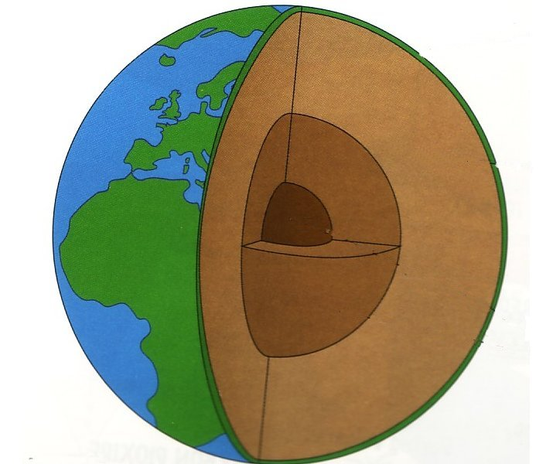
The Earth
Crust
10km to 100km thick
Mantle
Extends almost halfway to centre Solid properties but flows
Core
Iron & Nickel Just over half the Earth’s radius Liquid outer core Solid inner core
The average density of the Earth is much greater than the density of the rocks that form the crust. This means that the interior of the Earth is made from different and denser materials than the crust

Slide 3
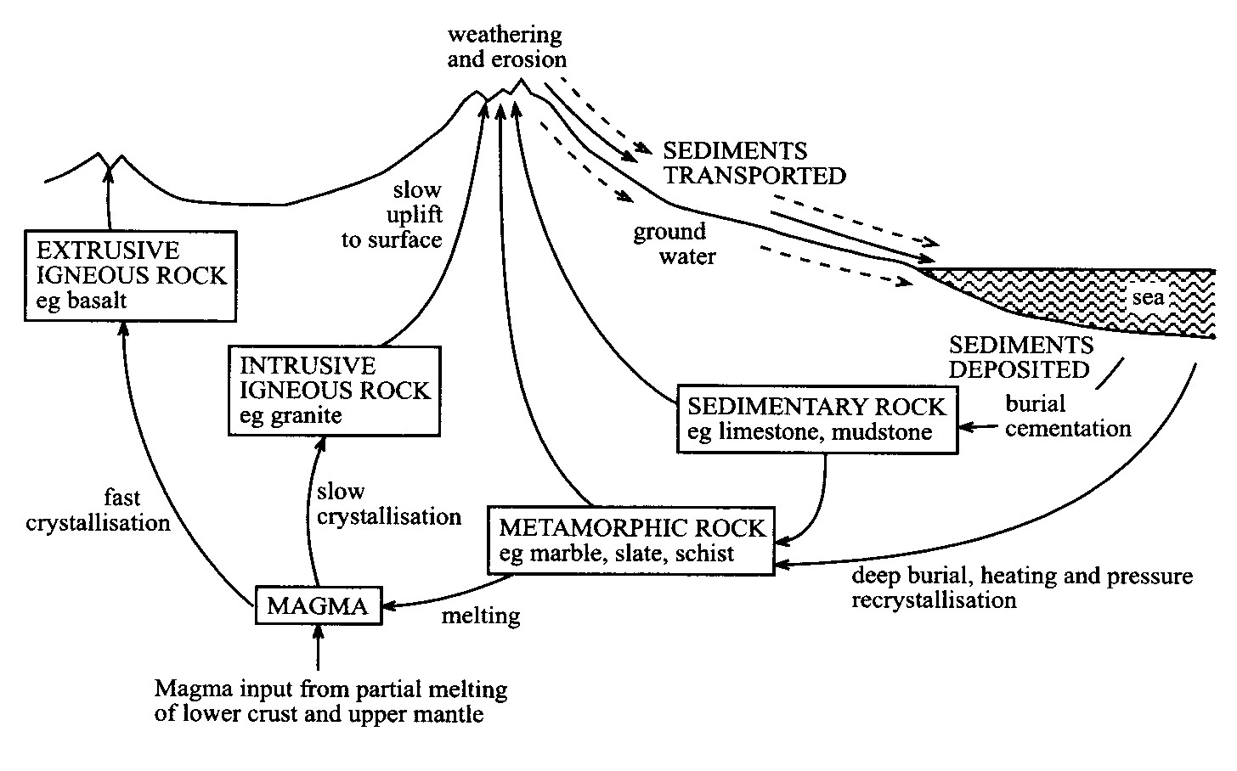
The Rock Cycle
Layers Ripples Fossils
Sedimentary rocks
Metamorphic rocks
Igneous rocks
Formed by high pressure & temperature Evidence of mountain building processes Associated with Earth movements
Have been molten Crystals Intrusive – big crystals Extrusive – small crystals

Slide 4
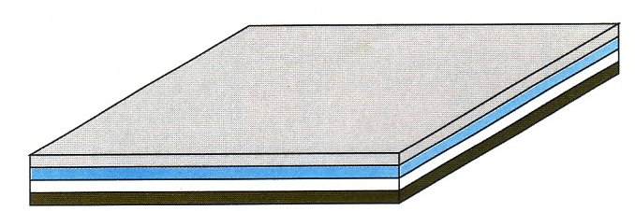
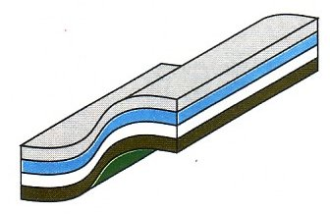
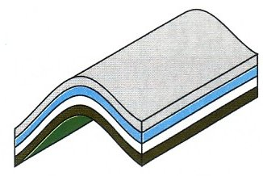
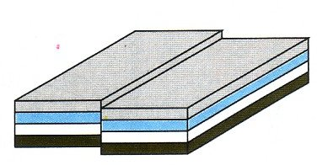
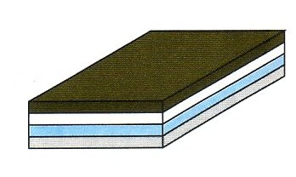
The Crust
Young
Sedimentary rocks in layers Younger rocks usually on top of older rocks
Old
Sedimentary rocks are also found:
Tilted
Folded
Fractured
Upside down
This shows that the Earth’s crust is unstable and has been subjected to very large forces

